Slide 1
Insights from COVID-19 US Symptoms Data
Mark Jung
University of Maryland, College Park
College of Computer, Mathematical, and Natural Sciences

Slide 2
Problem Statement
UMD’s Joint Program in Survey Methodology and CMU’s Delphi Research Group collaborated with Facebook to survey users about their symptoms, behaviors, and mental health.
Questions
What is the predictive power of these indicators in forecasting COVID-19?
Which indicators are the most useful?
What models make the best use of these indicators?
Facebook (COVID) Symptom Survey | JPSM | Joint Program in Survey Methodology | University of Maryland (umd.edu)
Delphi's COVID-19 Surveys | DELPHI (cmu.edu)
https://dataforgood.fb.com/tools/symptomsurvey/

Slide 3
Data
Confirmed COVID-19 cases / deaths
Source
September 8, 2020 – February 19, 2021
Smoothed with 7-day trailing average
Weighted with Facebook-provided weight to more accurately represent US population
JHU Cases and Deaths
Facebook Survey
Facebook survey began April 4, 2020 but other indicators only available beginning on Sep. 8, 2020
Per 100,000 people
John Hopkins University report
Illness, behavioral, mental health indicators (next slide)
CMU COVIDcast API
US data
Home - Delphi Epidata API (cmu-delphi.github.io)

Slide 4
Facebook Survey Indicators
Signal | Description
Community COVID-like Illness | % of people reporting COVID-like illness (fever, along with cough, or shortness of breath, or difficulty breathing) in their local community, including their household
Wearing Mask (C13) | % of people who wore a mask for most or all of the time while in public in the past 5 days
Traveled Outside State (C13) | % of respondents who report traveling outside their state in the past 5 days
Worked Outside Home (C13) | % of respondents who worked or went to school outside their home in the past 24 hours
Spent Time With Others (C13) | % of respondents who “spent time with someone who isn’t currently staying with you” in the past 24 hours
Attended Large Event (C13) | % of respondents who “attended an event with more than 10 people” in the past 24 hours
Used Public Transit (C13) | % of respondents who “used public transit” in the past 24 hours
Anxious (C8) | % of respondents who reported feeling “nervous, anxious, or on edge” for most or all of the past 5 days
Depressed (C8) | % of respondents who reported feeling depressed for most or all of the past 5 days
Felt Isolated (C8) | % of respondents who reported feeling “isolated from others” for most or all of the past 5 days
Worried Become Ill (C9) | % of respondents who reported feeling very or somewhat worried that “you or someone in your immediate family might become seriously ill from COVID-19”
Worried Finances (C15) | % of respondents who report being very or somewhat worried about their “household’s finances for the next month”

Slide 5
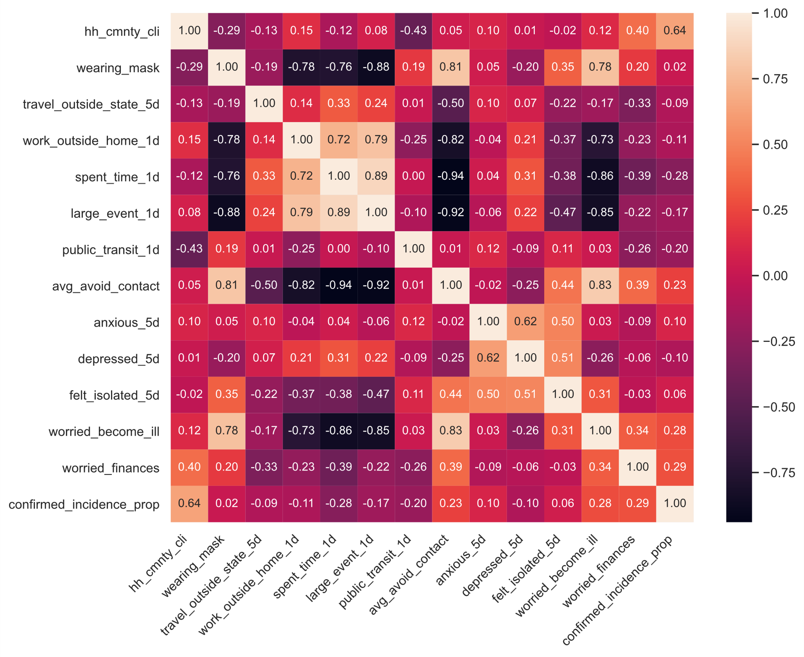
Correlation Matrix US data

Slide 6
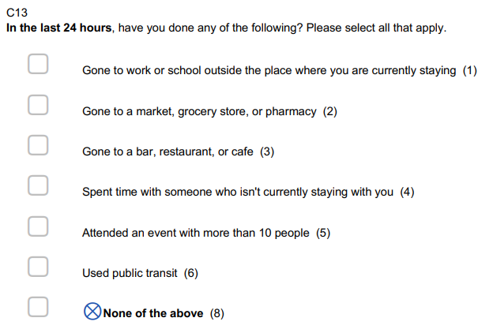
Data Preparation & Methodology
Behavioral indicators do not include percentage of people with no outside contact
Add ‘avg_avoid_contact’ by subtracting average from 100
Fit models using all indicators (except Community CLI) to predict new cases (confirmed_incidence_prop) using default parameters
Linear Regression (LR)
Lasso (alpha = 1)
K Nearest Neighbors (KNN) (n=5)
Support Vector Regression (SVR) (C = 1)
Random Forest (RF)
Facebook Survey Item C13

Slide 7
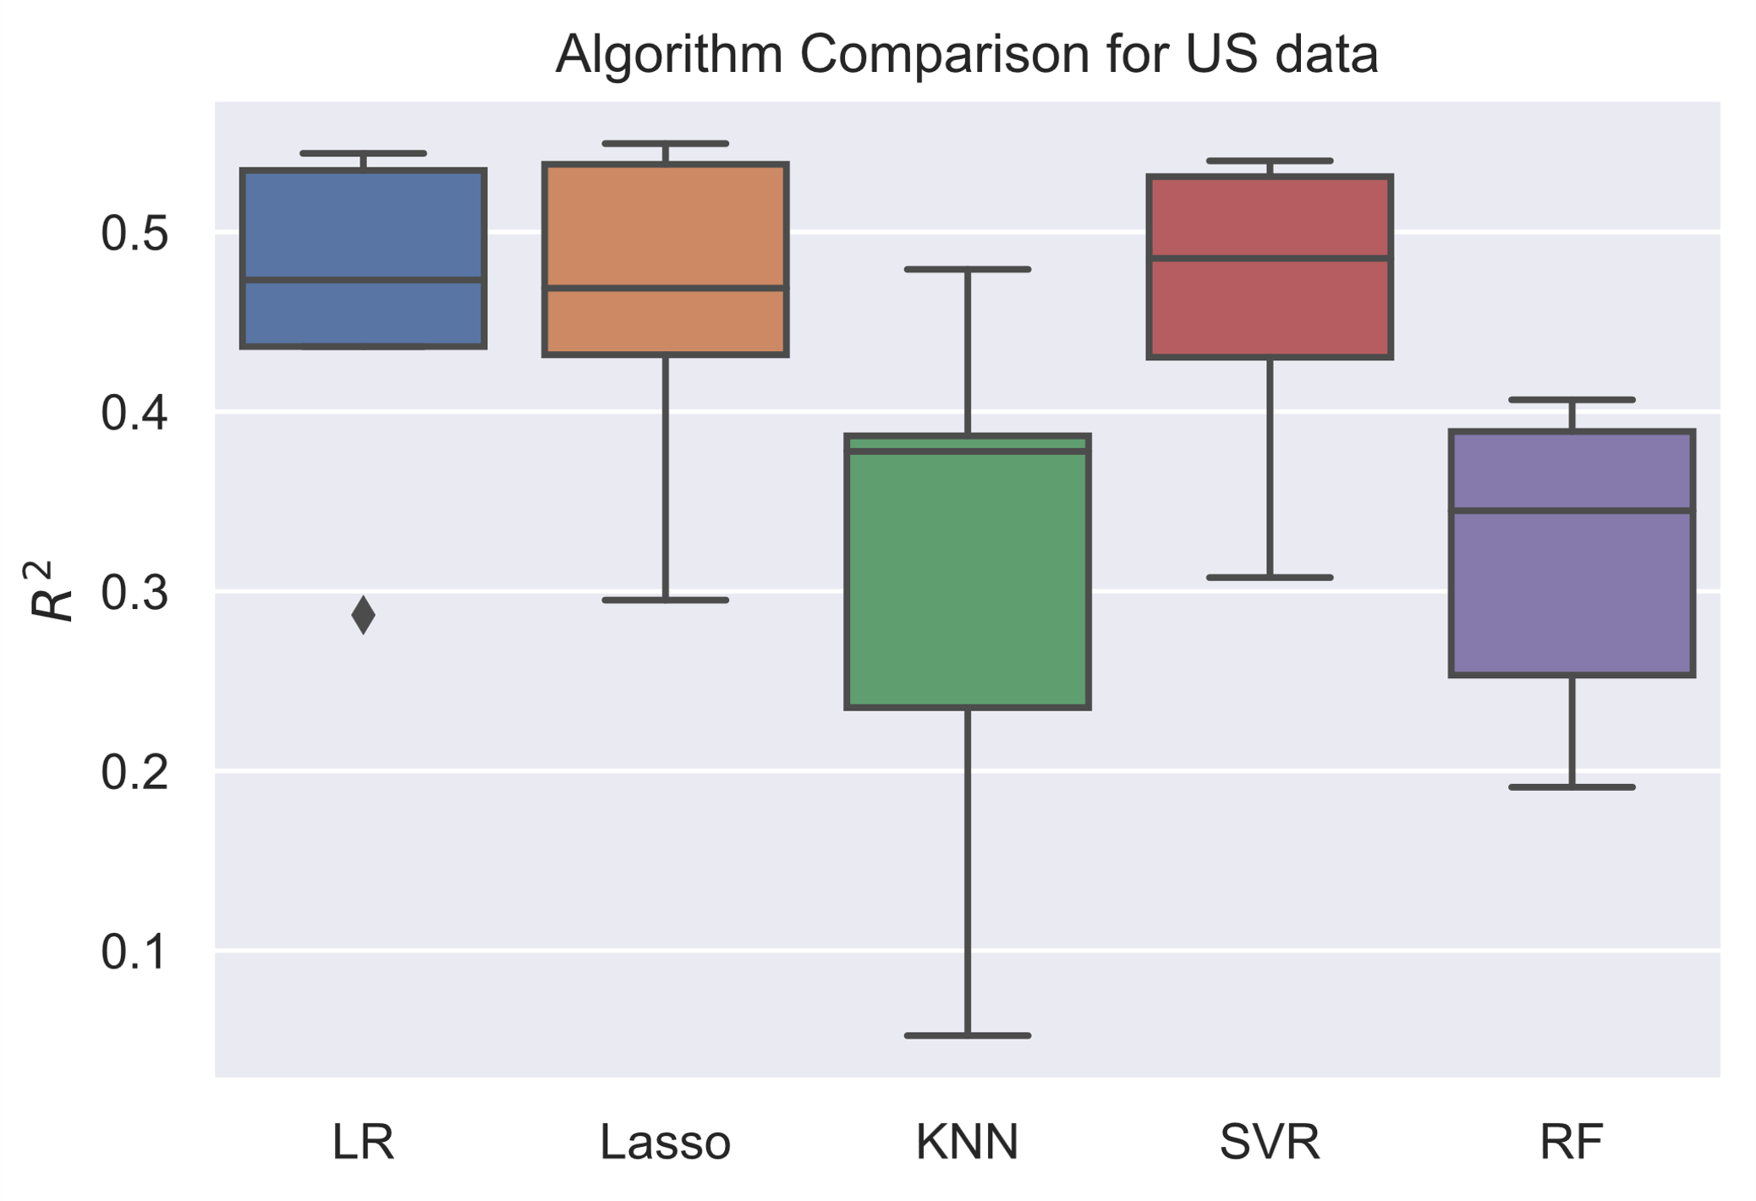
Algorithm Comparison
Using Python sklearn
Cross-validation: TimeSeriesSplit of 5
About 5 months of complete data
K-fold CV shuffles data

Slide 8
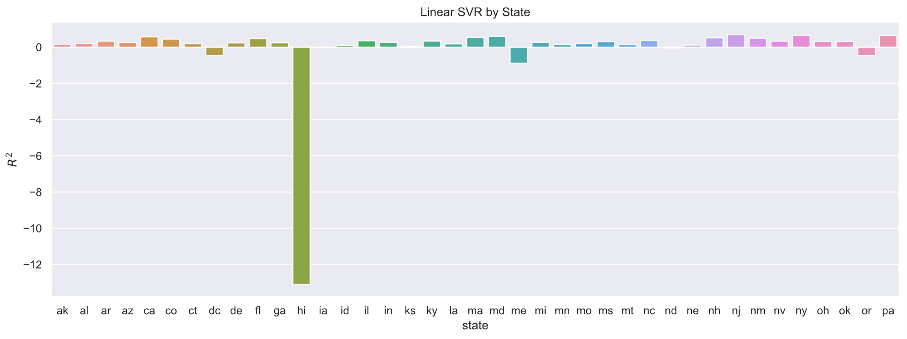
SVR by State
Hawaii

Slide 9
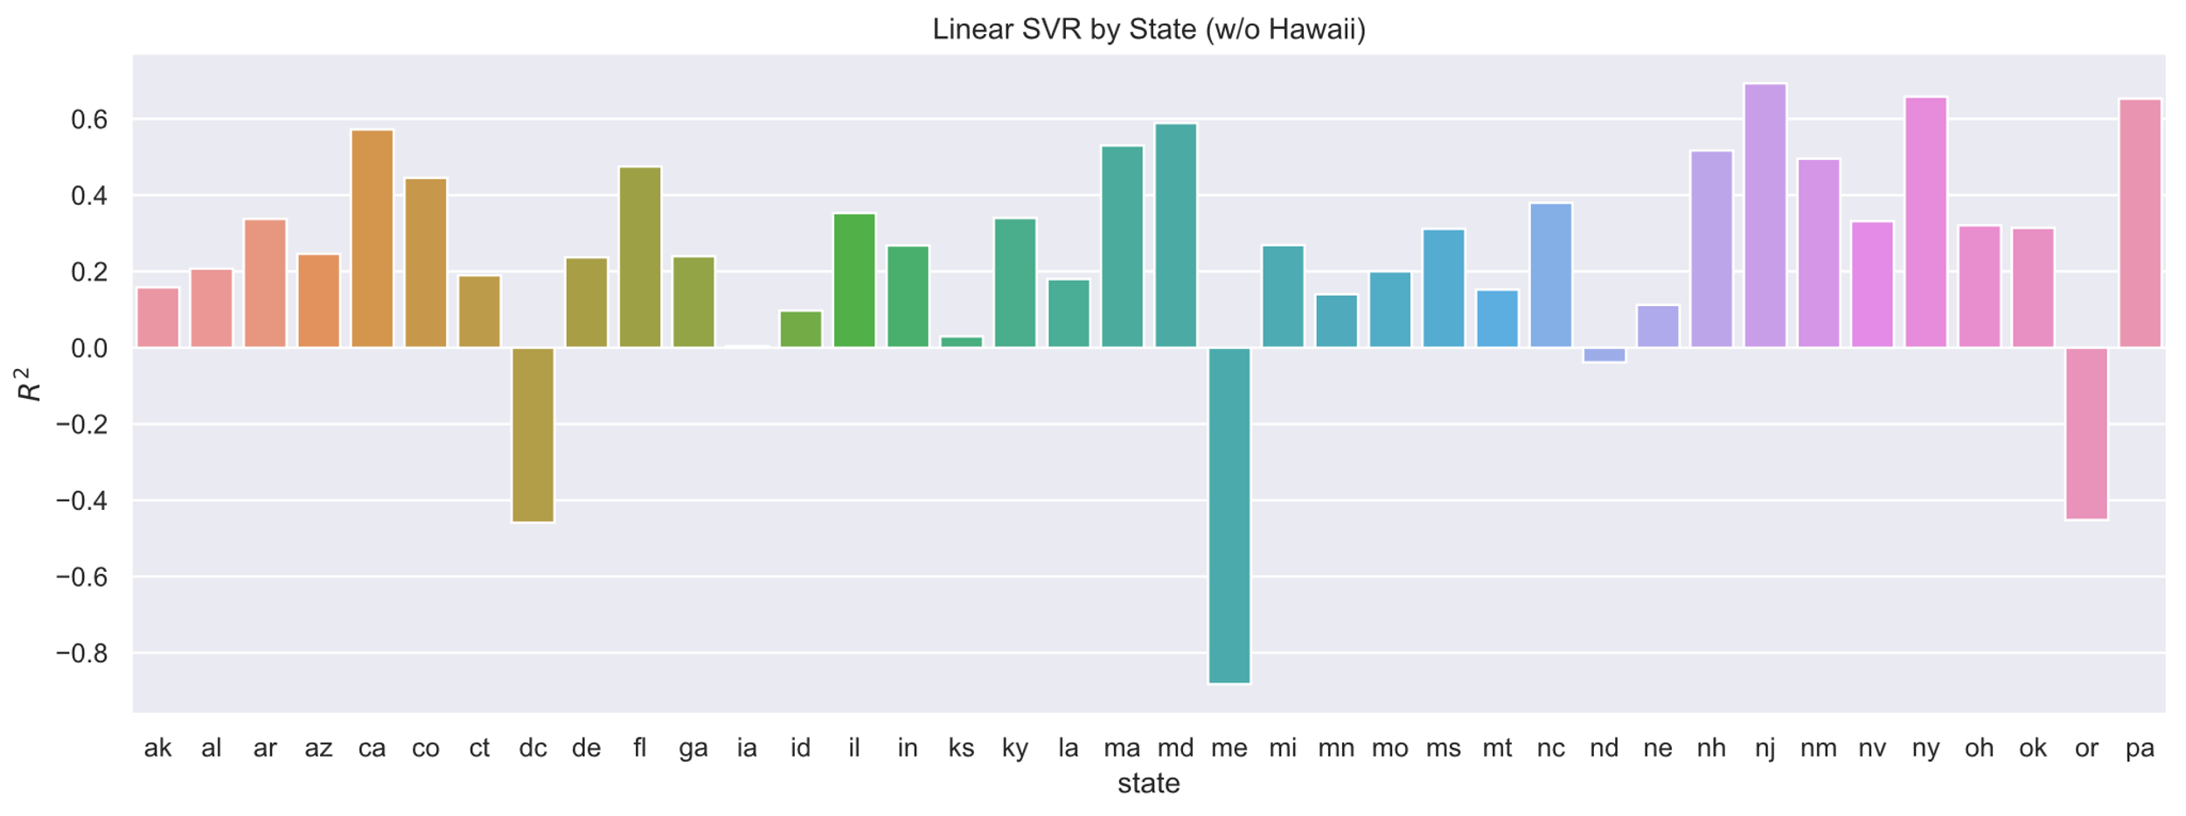
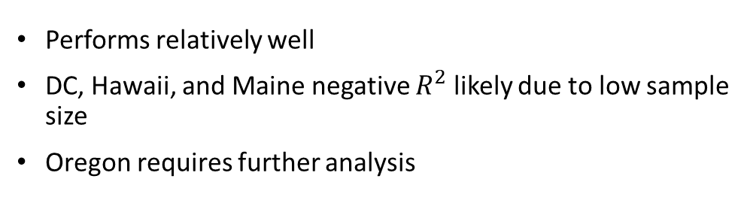
SVR by State (Hawaii removed)
Performs relatively well
DC, Hawaii, and Maine negative $R^{2}$ likely due to low sample size
Oregon requires further analysis
DC
Oregon
Maine

Slide 10

Results
Which indicators are the most useful?
Community CLI is strongly correlated (.64) to actual new cases
Behavioral indicators are negatively correlated ($−0.3≤x≤−0.1$)
Mental health indicators are positively correlated
Especially “worried about becoming ill” and “worried about finances” ($0.28≤x≤0.29$)
Note to policymakers

Slide 11

Results
What is the predictive power of these indicators in forecasting COVID-19?
Using only the indicators, we can achieve mean $R^{2}$ of $0.45$
What models make the best use of these indicators?
Support Vector Regression performs slightly better than Linear and Lasso
Linear and Lasso likely better for targeted analysis and ease of interpretation

Slide 12

Further analysis
Stratify by age (not available in COVIDcast API)
Use linear regression with interaction variables
Introduce time lag

Slide 13
Thanks!
Special thanks to Dr. Adam Lee from Robert H. Smith School of Business

